Slide 1

Group 7 Sprint 4
By: Neal Roche, Jason Schray, and Aaron niTZBERG

Slide 2
Sprint 1-3 Overview
Sprint 1 | Sprint 2 | Sprint 3
Circumnavigate the room H2208 | Robot must complete the figure eight course 5 times | Avoid 3 objects in the robot’s path
Robot must speak multiple statements | Robot must speak and flash multicolored lights | Complete a jump over a small ramp
Robot must travel to each yellow tile and make a right turn at the center | Robot must stop where it started | Knock down pins at the conclusion of the course

Slide 3
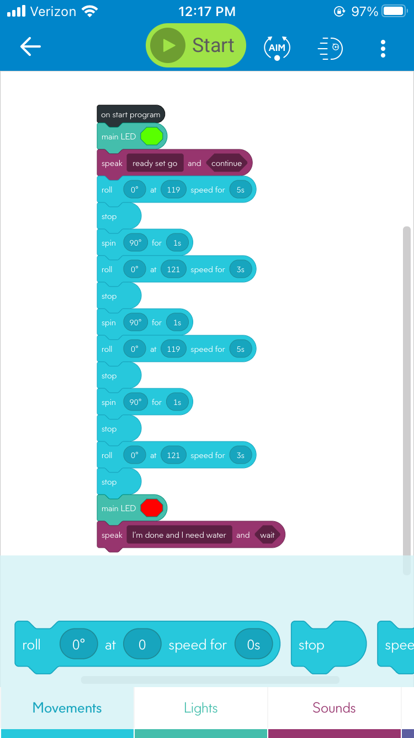

Sprint 1
Github:
https://github.com/Nroche24/Endurance
Difficulties:
Obtaining the robot
Formatting the documents correctly such as the SDD, Flowchart, Gantt Chart
Replicating the course without using the classroom
Meeting the timeline

Slide 4
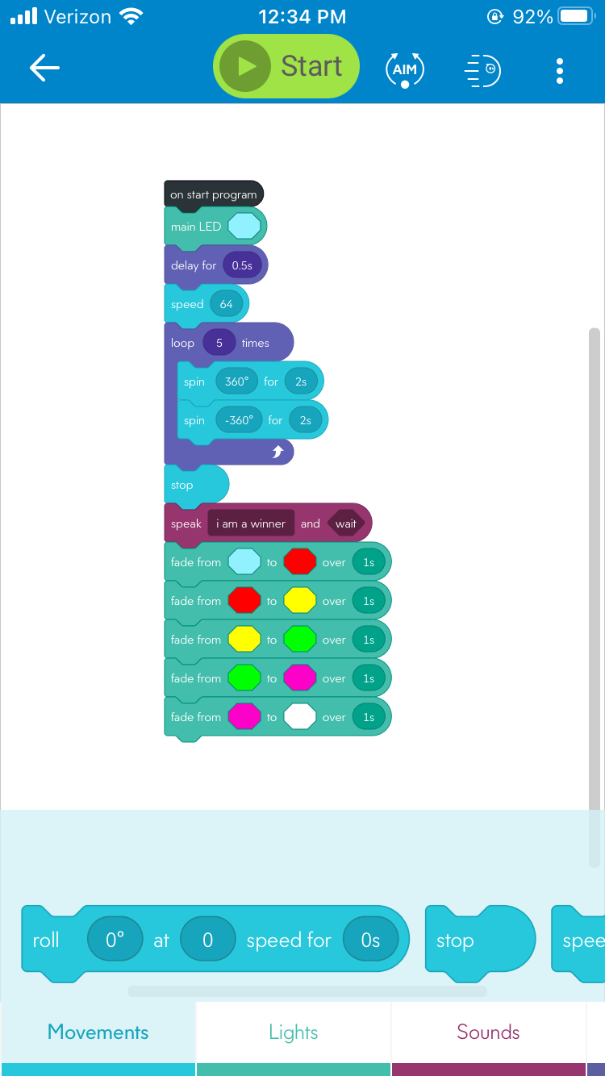
Sprint 2
Github:
https://github.com/Nroche24/Accuracy
Difficulties:
Robot starting/stopping in the same spot
Obtaining the correct firmware update for the robot
Replicating the course without using the classroom
Figuring out the correct algorithm to create the figure eight

Slide 5
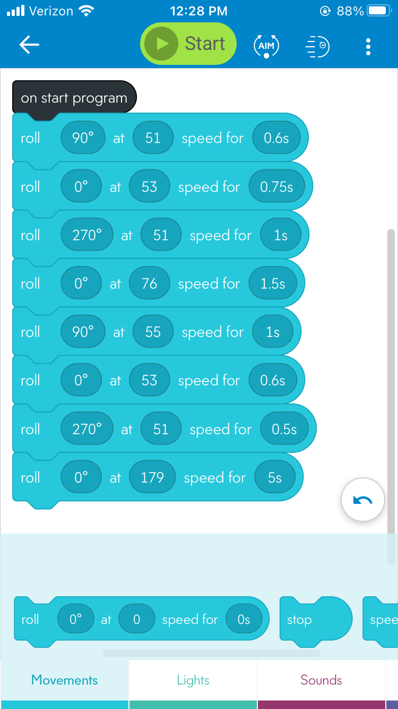
Sprint 3
Github:
https://github.com/Nroche24/AGILITY
Difficulties:
Robot not colliding with homemade course
Getting materials to replicate course
Github transfer of documents from collab branch to main branch

Slide 6
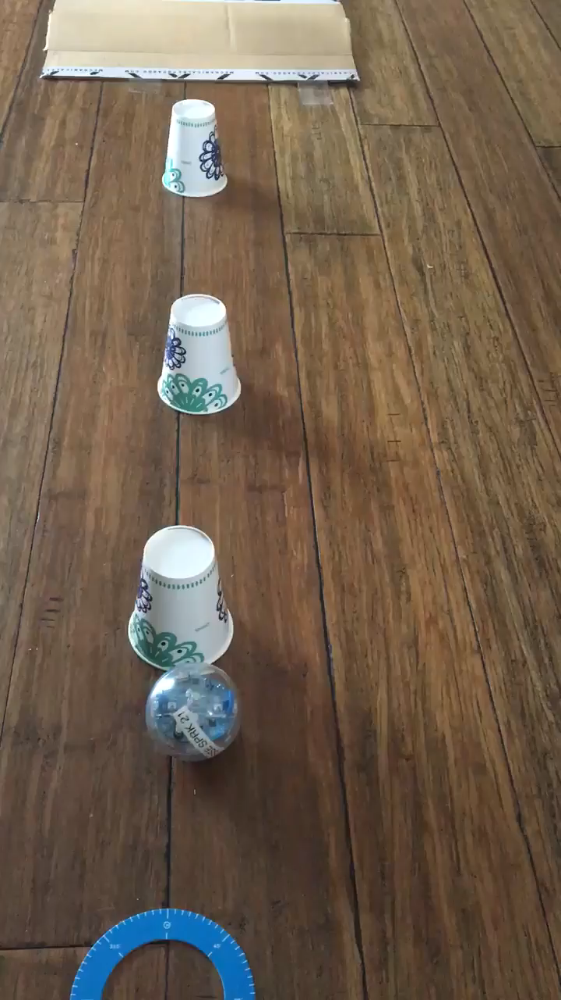
Sprint 3 Video

Slide 7

Roles
Team lead- Neal R.
Responsible for planning the work to be accomplished as well as creating the timeline the group will follow
Robotics Engineer- Aaron N.
Designs software needed for the robot to function and documents the data
Data Coordinator- Jason S.
Take the data output given by the Robotics Engineer and formats it into charts and other documents

Slide 8

Group Challenges/Hardships
Location: All members of the team lived over an hour away from each other, with two members being over an hour away from campus
Accuracy: Team had problems replicating the figure eight sprint to correctly stop and start in the same location. Originally thought to be a hardware error
Communication: Initially there was some miscommunication amongst the team because of the different schedules but they were corrected but caused some delays
Formatting: Collecting and representing the data properly in the System Design Document, Flowcharts, and Algorithms

Slide 9

Difficulties: Team Lead
Clear and concise communication to team on requirements
Not having physical access to robot to help test theories
Formatting documents and transferring them from Github collab branch to Github main branch

Slide 10
Difficulties: Data Coordinator
Creating Flowcharts and deciding which parts of Algorithm would be made into decisions.
Defining role names and helping define the purpose for each role
Not having physical access to the robot to help troubleshoot

Slide 11
Difficulties: Robotics Engineer
Determining if there was an initial hardware/software issue with the robot
Creation of Block Code, video and course utilized by the robot

Slide 12

How Can We Improve?
Time Management: This will maximize efficiency of the team and ensure that the goal is accomplished without sacrificing vital requirements
Improved Initial Planning: Laying out the groundwork early on so the team can get started earlier will directly contribute to meeting goals on time and help the team become more efficient
Rotate roles for each sprint so that each team member has a better understanding of how that role functions and what the expectations are

Slide 13

What Did We Learn?
Software Engineering is vital for many day-to-day things that are taken for granted
Even the simplest tasks have complicated processes behind them such as making a robot move forward/backward or creating a program to receive inputs and provide outputs
Meeting budgets and timelines are essential in the software development process as it directly correlates to quality
Programming is a rare skill that is not common, yet it drives the process in most things around us

Slide 14

Resources
Agility Sprint Video:
https://i.imgur.com/745vbrj.mp4
Github Presentation Link:
https://github.com/Nroche24/Presentation

